Slide 2
Reference
https://dj4e.com/lectures/SQL-01-Basics.txt

Slide 3
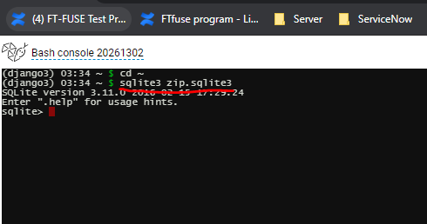
Create sqlite database
cd ~
Sqlite3 zip.sqlite3

Slide 4
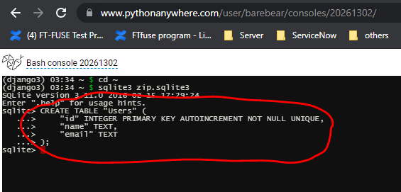
Create a new table

Slide 5
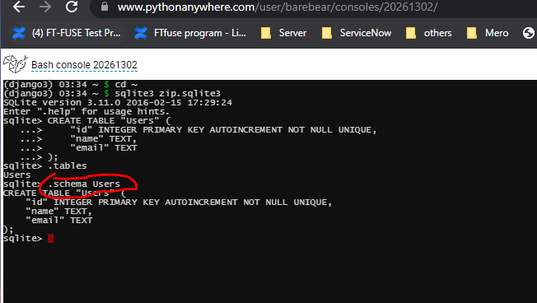
Check contents of the newly created table
.schema Users

Slide 6
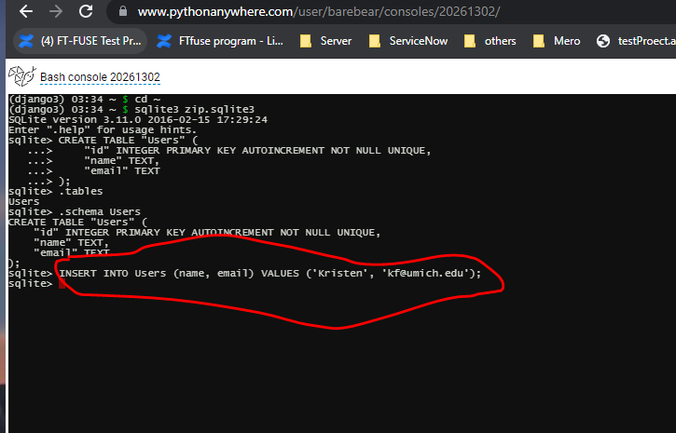
Add information into the table

